Slide 1

Digital Portfolio
STUDENT NAME: VIJAYARAGAVAN S
REGISTER NO AND NMID: 2422k2225 & 847829D5BDCDE85B5FF4803FD
DEPARTMENT: Computersceince
COLLEGE: COLLEGE/ UNIVERSITY:puratchi thalaivi amma goverment arts and science barathiyar university

Slide 2

PROJECT TITLE: DIGITAL PROTFOLIO
Di
Digital portfolio: VIJAYAYARAGAVAN S

Slide 3


AGENDA
Problem Statement
Project Overview
End Users
Tools and Technologies
Portfolio design and Layout
Features and Functionality
Results and Screenshots
Conclusion
Github Link
3/21/2024 Annual Review

Slide 4
PROBLEM STATEMENT:
Students often struggle to present their academic achievements, skills, and projects in a structured and professional manner. Traditional resumes fail to capture creativity, practical skills, and hands-on experiences, making it difficult for students to stand out in academic or career opportunities. There is a need for a digital portfolio solution that allows students to effectively showcase their competencies, projects, and growth.

Slide 5

PROJECT OVERVIEW
By developing this portfolio system, students will have a personalized digital identity that goes beyond a traditional CV, enhancing their chances of securing opportunities in competitive environments. It will also provide academic institutions and recruiters with a reliable and holistic view of a student’s potential

Slide 6

WHO ARE THE END USERS?
Primary End Users: Students
Secondary End Users: Employers, recruiters, faculty, mentors, admission officers

Slide 7

TOOLS AND TECHNIQUES
TOOLS:
TREBEDIT
TECHNIDES:
HTML
CSS
JAVASCRIPT

Slide 8
POTFOLIO DESIGN AND LAYOUT
A well-designed portfolio layout ensures clarity, professionalism, and impact while making it easy for recruiters and mentors to quickly assess a student’s strengths.
8th slide
8

Slide 9
FEATURES AND FUNCTIONALITY
🔹 About
This section is where you introduce yourself.
Example:
"I am. Computer Science student. I am passionate about learning new technologies and improving my skills in programming and development.
🔹 Certificates
Here you list your achievements – online courses, workshops, or competitions.
Example:
Completed Python Programming Course.
Attended Web Development Workshop.
Certificate in Data Science Basics.

Slide 10
🔹 Education.
This section shows your study background.
🔹 Skills
Here you highlight what you can do.
🔹 Contact Your contact information so people can reach you.

Slide 11
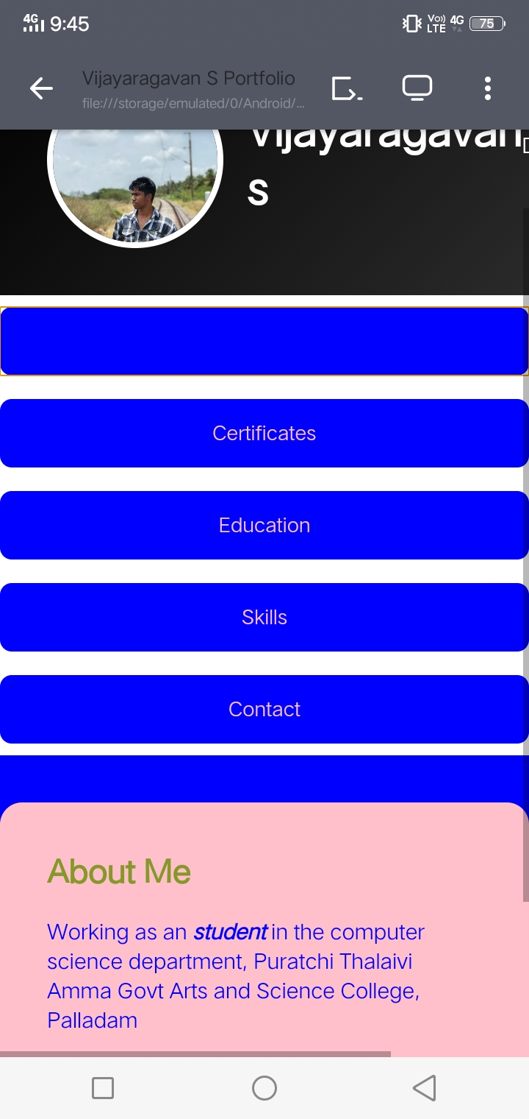

RESULTS AND SCREENSHOTS
3/21/2024 Annual Review
11

Slide 12
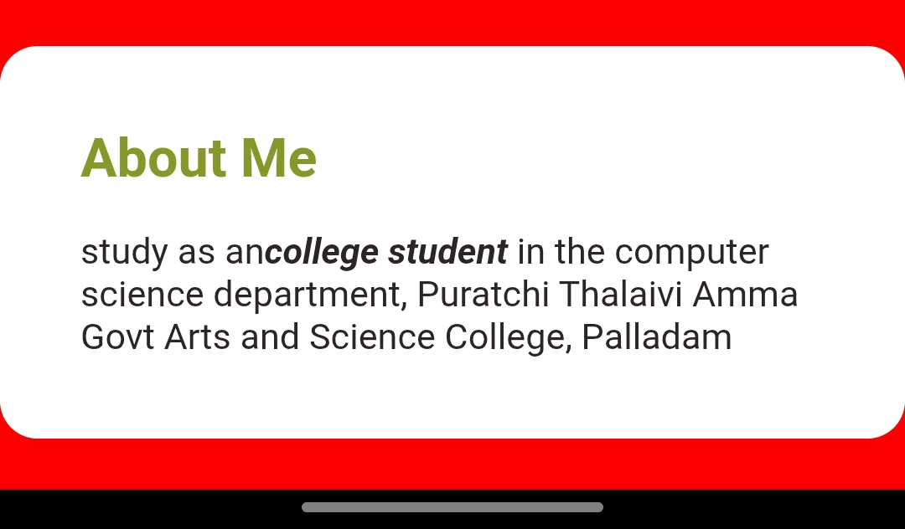

Slide 13
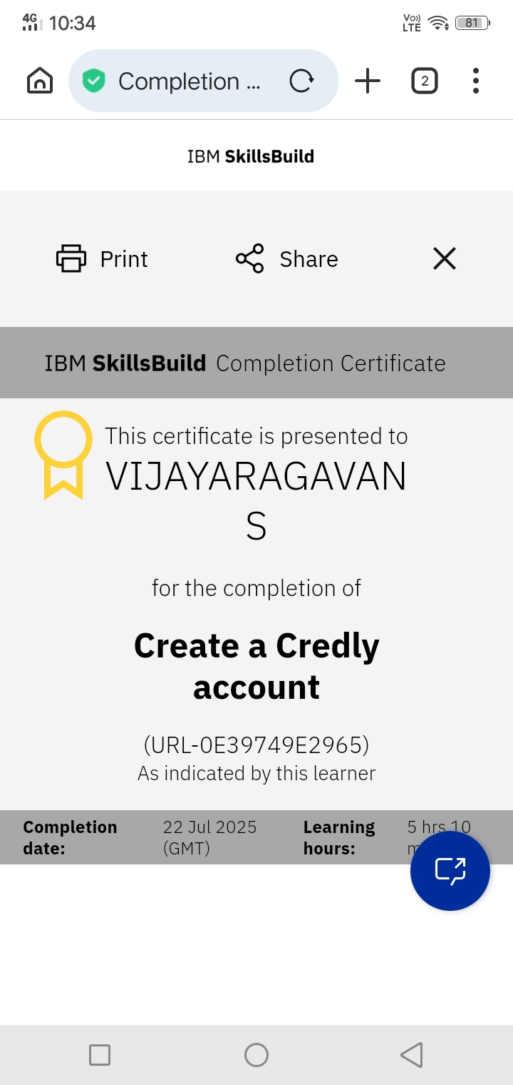

Slide 14


Slide 15
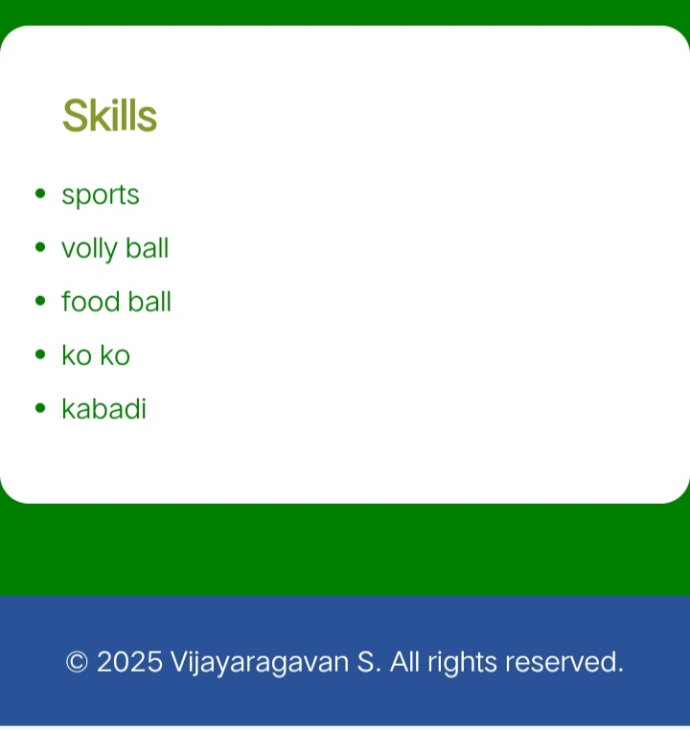

Slide 16
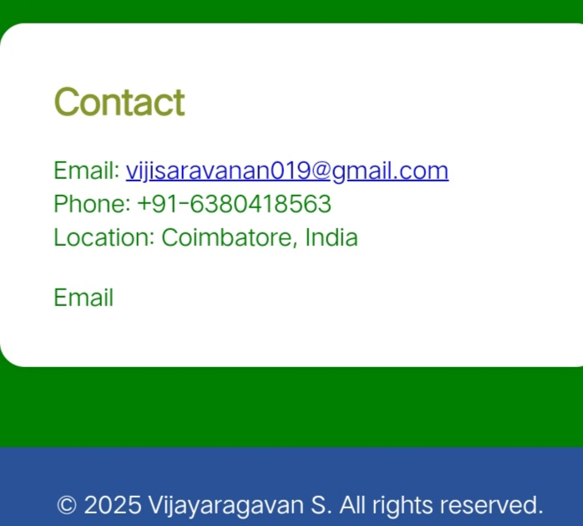

Slide 17
CONCLUSION
Responsive Design using media queries for better mobile compatibility.
Tab Navigation to switch between sections smoothly.
Dark Mode Toggle for enhanced user experience.
Password-protected Profile Image Update with local storage support.
Certificate Showcase and External Links for social media and published works.
17

